Slide 1
STOCK PRICE ANALYSIS

Slide 2
INTRODUCTION
A stock is the small chunk of ownership in the company. The stock price of the company reflects the net evaluation of the company and also gives a little insight into its performance. These stocks are traded on exchanges and their prices are constantly changing due to their demand and supply in the market.

Slide 3


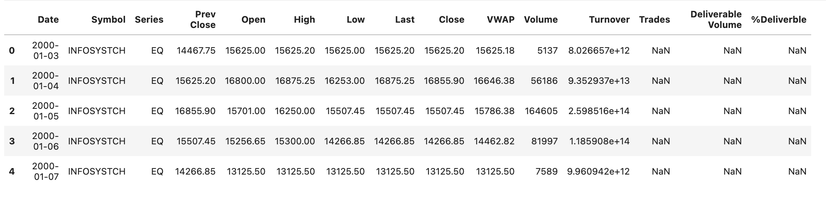
we will use INFOSYS data set (2000 - 2021) to analyze stock prices and perform some basic time series operations.
.

Slide 4
Following are the python library which we had used for project:-
pandas It has functions for analyzing, cleaning, exploring, and manipulating data.
Matplotlib It is an amazing visualization library in Python for 2D plots of arrays.
Seaborn Seaborn is a library that uses Matplotlib underneath to plot graphs. It will be used to visualize random distributions

Slide 5
Prerequisties
import pandas as pd
import matplotlib.pyplot as plt
import matplotlib.dates as mdates
import seaborn as sns

Slide 6
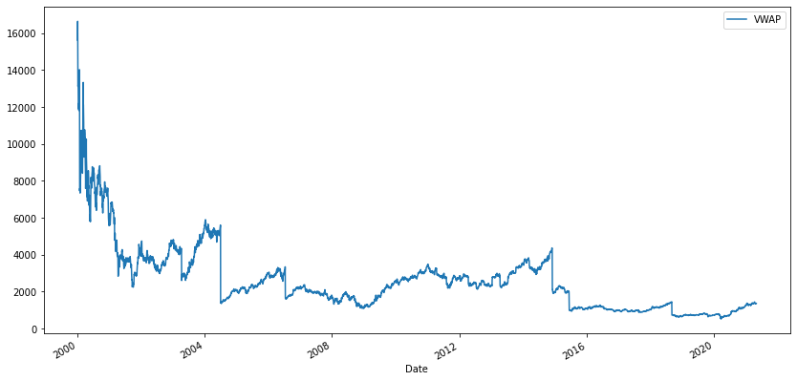
VWAP
The volume weighted average price (VWAP) is a trading benchmark used by traders that gives the average price a security has traded at throughout the day, based on both volume and price.
We visualize the VWAP of INFOSYS shares and plot VWAP to visualize how the prices and value fluctuate over time.

Slide 7
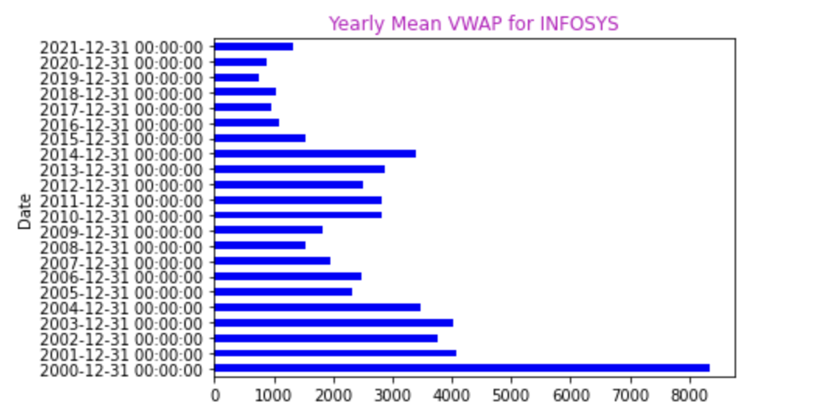
Year end resampling
Stock price of a single day is not fit to make any analysis hence we need to aggregate data in some way. Either we aggregate the data based on month,or start of each year

Slide 8
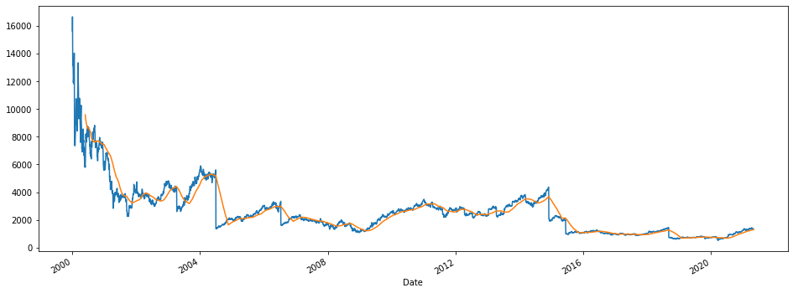
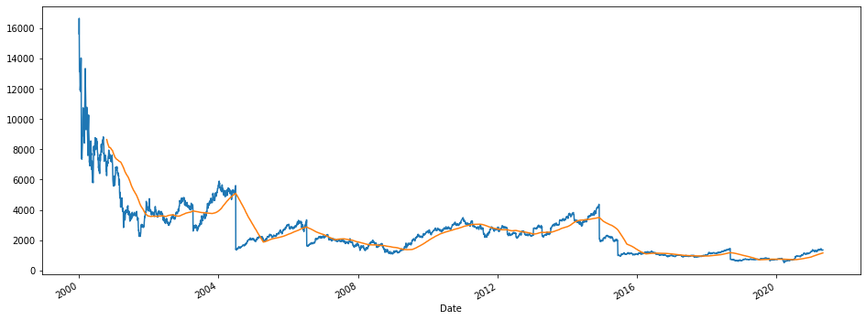
100 and 200 days moving average

Slide 9
A project by
Harsh Patel
Kirtan patel

